Slide 1
Git Basics Training
Hands-on Workshop on the Fundamental concepts of Git version control and Github
Faye Nielsen, Mario Krapp, Jack Drummond, Quyen Nguyen

Slide 2
Agenda
Intro & Key Concepts
Git (local) Fundamentals
GitHub and Collaboration
Discussion & Wrap up

Slide 3
What is Git and Github?
Git is known as a version control system
Version control is a system that records changes to a file or set of files over time so that you can recall specific versions later.
Github is an online platform to store files in the cloud which enables backed up storage, sharing/collaborating with others, easy integration with other cloud softwares

Slide 4
Why is it useful?
Git is a time machine for your code that creates snapshots of your work, letting you easily revert to previous versions and experiment safely.
Example:
You're analysing earthquake data with analyse_data.py. You add a new visualisation function, but it breaks your entire analysis. What changed?
Without Git: analyse_data_v1.py, analyse_data_v2_final.py etc.
With Git: One file. Instant revert to the last working version with a single command. Essential when working with complex research code or collaborating with others.

Slide 5
How does it work?
Essentially, Git is simply a turbocharged save button.
A save in Git is called a commit. When you make a commit, you take a snapshot of all the files that are in the folder which you have initialised git in – otherwise known as your git repository, or repo for short.
This snapshot saves everything in it’s current state, and that particular commit can then be accessed further down the line if you mess anything up.

Slide 6
Repository (repo for short)
A folder/directory that is tracked by git (i.e. it has a .git folder)

Slide 7
Repository (repo for short)
A folder/directory that is tracked by git (i.e. it has a .git folder)
A local repository is on your local machine e.g. laptop, PC
A remote repository is hosted on a server e.g. Github, Gitlab

Slide 8
The Three States / Areas
Working directory
Where you edits files and do your work
Repository
Files saved to and tracked by Git
Staging area
Where files are prepared for saving to Git

Slide 9
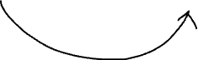
The Three States / Areas
Working directory
Where you edits files and do your work
Repository
Files saved to and tracked by Git
Staging area
Where files are prepared for saving to Git
Add

Slide 10
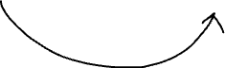
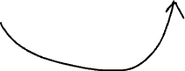
The Three States / Areas
Working directory
Where you edits files and do your work
Repository
Files saved to and tracked by Git
Staging area
Where files are prepared for saving to Git
Add
Commit

Slide 11
Add
‘Stage’ files
Prepare files to track in Git by selecting which ones you want to save
This is useful as you might only want to save one file, and leave the others out as they are not needed

Slide 12
Commit
Snapshot of all files at that moment in time, including the changes you ‘staged’ by using the ‘add’ command
These are the building blocks of your version control history, when you look back through them you will see what changed between one commit and the next
Has a unique ID, message, author and timestamp

Slide 13
Branch
Parallel version of a project
Enables you to work on different features on different branches, rather than everything all together where it can get confusing
Enables multiple people to work on the same codebase without disrupting/breaking what someone else is working on
Gets merged back into the ‘main’ branch

Slide 14
Merge
Merging branches back into the ‘main’ branch

Slide 15
Instructions for use
This master template includes a range of slide layouts and design options. Please use the ones that best suit your presentation and delete any unused slides.
The logo slides at the beginning are intended as holding pages for conferences and events.
If you plan to print this presentation, please ensure font embedding is enabled to preserve typography and layout consistency.
To embed fonts:
Windows (PC): Go to File → Options → Save → Embed fonts in the file, then select Embed all characters.
Mac: Go to PowerPoint → Preferences → Save, then tick Embed fonts in the file.

Slide 18
Welcome to Earth Sciences New Zealand

Slide 19
Welcome to Earth Sciences New Zealand
On July 1, 2025 NIWA and GNS Science merged to become a new Public Research Organisation called Earth Sciences New Zealand

Slide 25
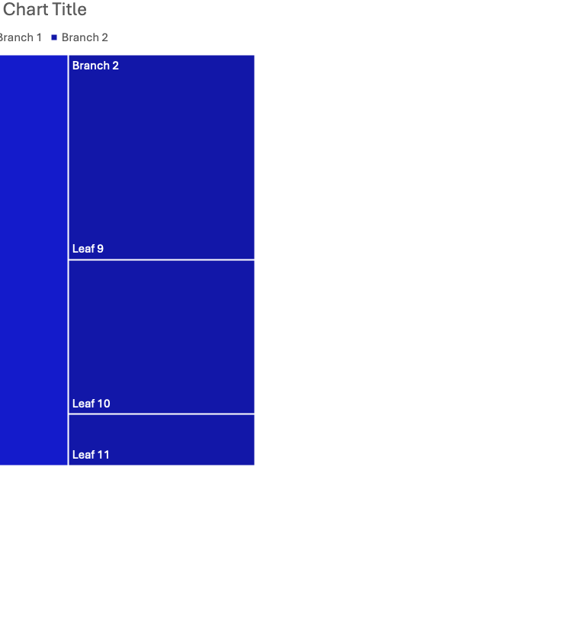

Slide 27
Heading

